Slide 1
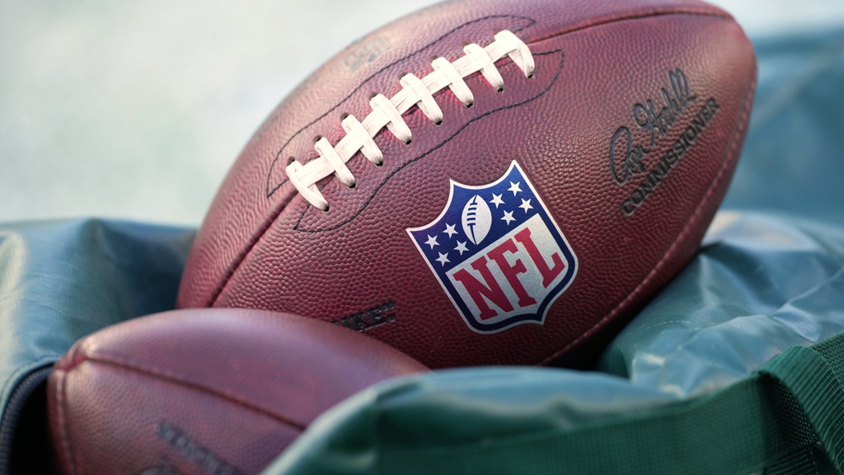
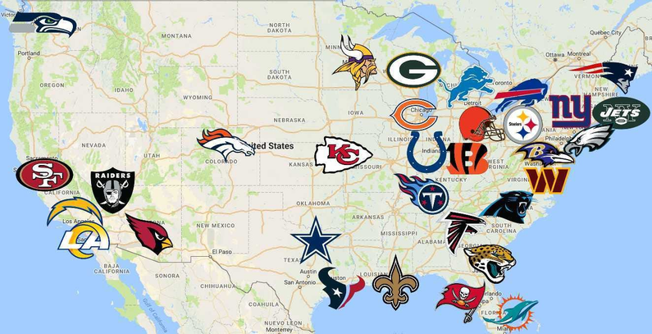
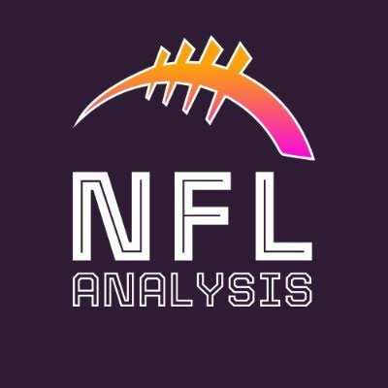
NFL OFFENSIVE STRATEGY ANALYSIS
HOW TEAMS ADJUST THEIR OFFENSE WHEN THE SCORE CHANGES.
JULIA SEE | SEPTEMBER 10,2026

Slide 2
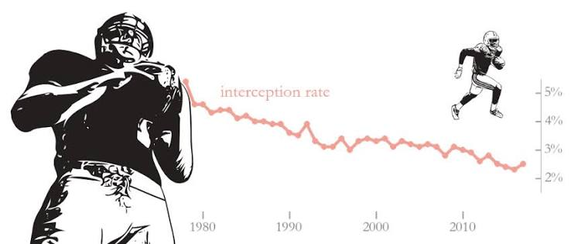
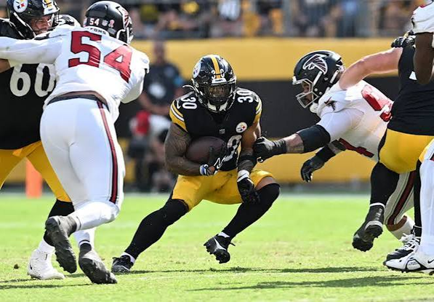
Research Question
How does offensive strategy change when NFL teams are winning vs. losing?
How does play selection change when teams trail by 7+ compared with when they are leading or tied?
  Passing vs. Rushing: How the percentage of pass and run plays changes as teams move from leading to trailing.
  Yards Gained: Whether passing or rushing produces different average yardage depending on the game situation.
  EPA: How the expected value of passing and rushing plays changes across different score situations.
  Changes Throughout the Game: How play selection shifts from the first quarter to the fourth quarter when a team is trailing by 7+ points.

Slide 3
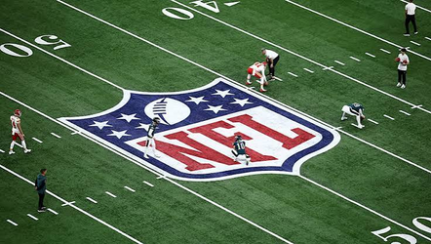
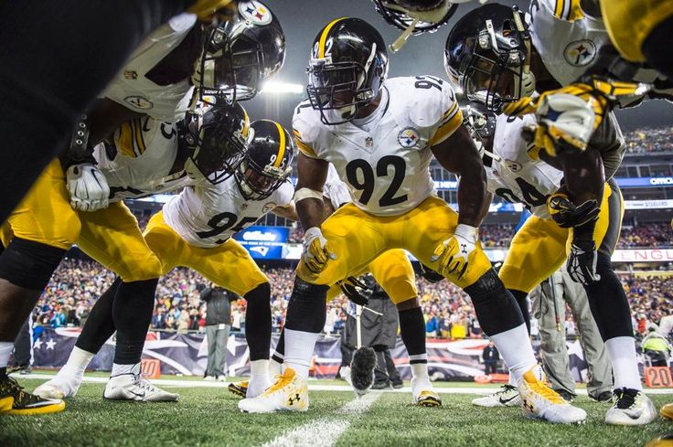
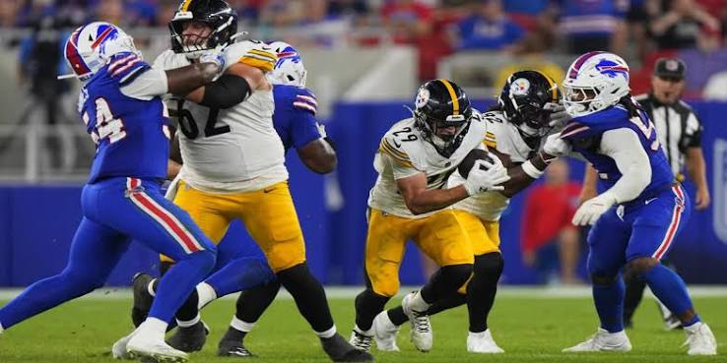
Data and Methodology
  DATA SOURCE
    NFL play-by-play data from nflverse
    2021–2024 seasons
    2024: 49,492 plays | 372 variables
  FILTERING
    Run + pass plays only
    35,050 offensive plays analyzed in 2024
  GAME SITUATIONS
    Leading: +1 or more
    Tied: 0
    Trailing: -1 to -6
    Trailing 7+: -7 to -13
    Trailing 14+: -14 or more
  MEASURES
    Pass vs. run percentage
    Average yards gained
    EPA
    Quarter-by-quarter play selection
    2021–2024 comparison

Slide 4
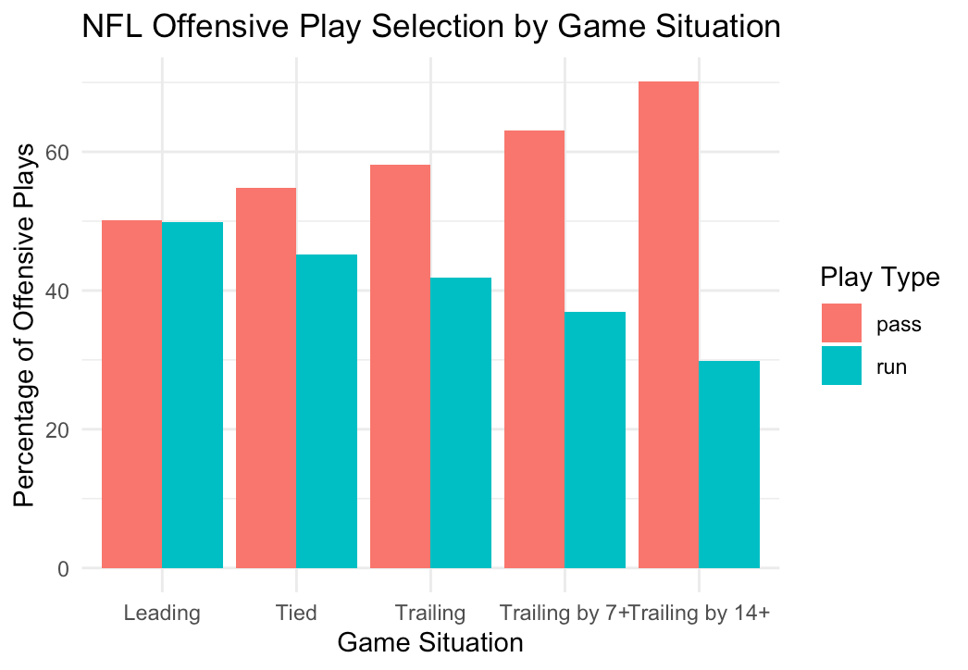
Play Selection by Game Situation
How Does the Score Affect Play Selection?
The further a team falls behind, the more frequently it passes.
  Leading: 50.09% pass | 49.91% run
  Trailing 7–13: 63.04% pass | 36.96% run
  Trailing 14+: 70.13% pass | 29.87% run
Key Finding:
  Passing increased by 20.04 percentage points from leading to trailing by 14+.

Slide 5
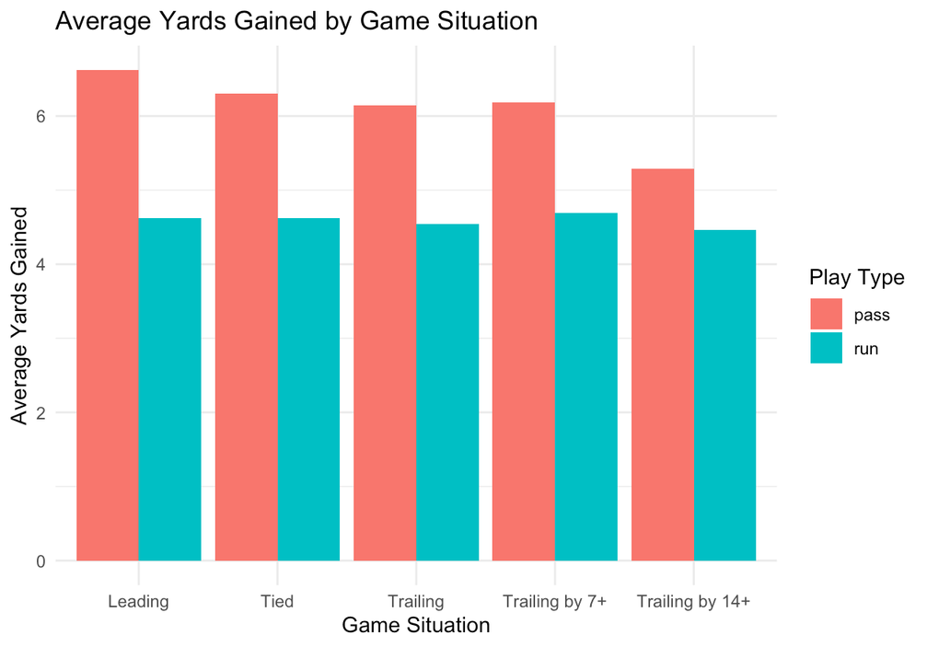
Offensive Efficiency
Does Passing More Mean Better Results?
Passing increased when teams fell behind, but passing efficiency decreased in larger deficits.
  Leading: 6.62 average passing yards
  Trailing 7–13: 6.18 average passing yards
  Trailing 14+: 5.29 average passing yards
  Trailing 14+ EPA: −0.122
Key Finding:
  More passing did not necessarily mean more efficient passing.

Slide 6
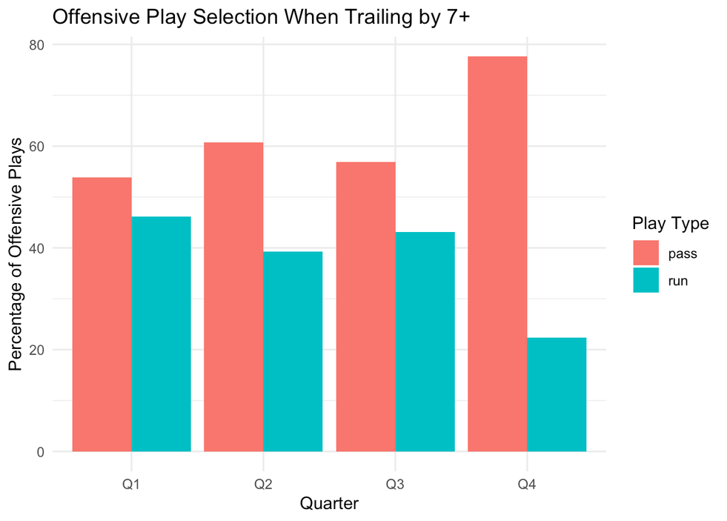
What Happens as the Game Progresses?
Passing Increases as the Clock Runs Down
When teams remained behind by 7+ points, passing became much more common later in the game.
Quarter | Pass Plays
Q1 | 53.81%
Q2 | 60.77%
Q3 | 56.91%
Q4 | 77.63%
Key Finding:
  Passing increased 23.82 percentage points from Q1 to Q4.

Slide 7
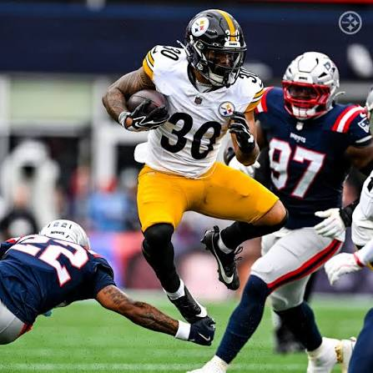
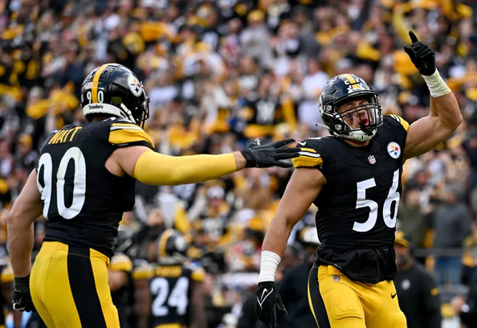
Multi-Season Results
Is This Pattern Consistent Across Seasons?
Passing remained around 63% when teams were trailing by 7+ points.
Season | Pass % When Trailing 7+
2021 | 63.69%
2022 | 62.97%
2023 | 63.09%
2024 | 63.04%
Key Finding
The results were remarkably consistent across all four seasons.
  Lowest: 62.97% in 2022
  Highest: 63.69% in 2021
  2024: 63.04%

Slide 8
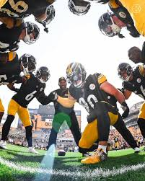
Key Findings & Limitations
What Did the Analysis Show?
Key Findings
  Passing increased as deficits became larger
  Passing increased substantially in the fourth quarter
  More passing did not necessarily mean greater efficiency
  The trailing 7+ pattern was consistent across 2021–2024
Important Limitations
  The analysis does not account for:
    Down & distance
    Time remaining
    Field position
    Personnel & injuries
    Weather
    Team offensive philosophy
The analysis identifies relationships between game situation and play selection, but does not establish that score differential alone causes these changes.

